Slide 1
Sierra Sands Unified School District
Engaging all Learners
2020-21 Budget
45 Day Budget Revision Update
Presented by: Pamela Smith
Lori McGuire
August 6, 2020

Slide 2
Why a 45 Day Revision?
Education Code specifies the requirement that districts adopt a budget for the following year by July 1 and includes this provision in E.C. 42127(h):
Not later than 45 days after the Governor signs the annual Budget Act, the school district shall make available for public review any revisions in revenues and expenditures that it has made to its budget to reflect the funding made available by that Budget Act
Governor Newsom signed the 2020-21 Budget Act on June 29 with several significant changes from the May Revision
A full revision of the budget is not a requirement during this time; rather it is an opportunity for communicating any material impacts of the amended State Budget on the district’s budget

Slide 3
Changes to the State Budget From May Revision
Proposed 10% Reduction to LCFF Restored
2.31% COLA not funded; 7.69% reduction eliminated
Establishes Deferral Apportionment Schedule for 20-21
Defers $9.175 Billion during 2020-21
If federal funding received by 15 Oct 2020, deferrals will be reduced
Provides Coronavirus Aid, Relief, and Economic Security (CARES) Act funding
Must adopt Learning Continuity and Attendance Plan (LCAP) by 30 Sept 2020
Provides $645 Million for Special Education Services

Slide 4
Changes to Revenues
Full LCFF funding minus COLA
MediCal administration adjustment
Net difference - $ 4,424,909.00
One-Time funding with restrictions on use
Special Education Funding Increase
One-Time funding with restrictions on use
Net difference - $6,171,721.00

Slide 5
Changes to Ending Fund Balances
CARES Act Funding
Expense Adjustments
CARES Act Funding
CARES Act Funding/Expense Adjustments*
* Depending on guidelines, district may be able to offset unrestricted expenses with CARES Act Funding

Slide 6
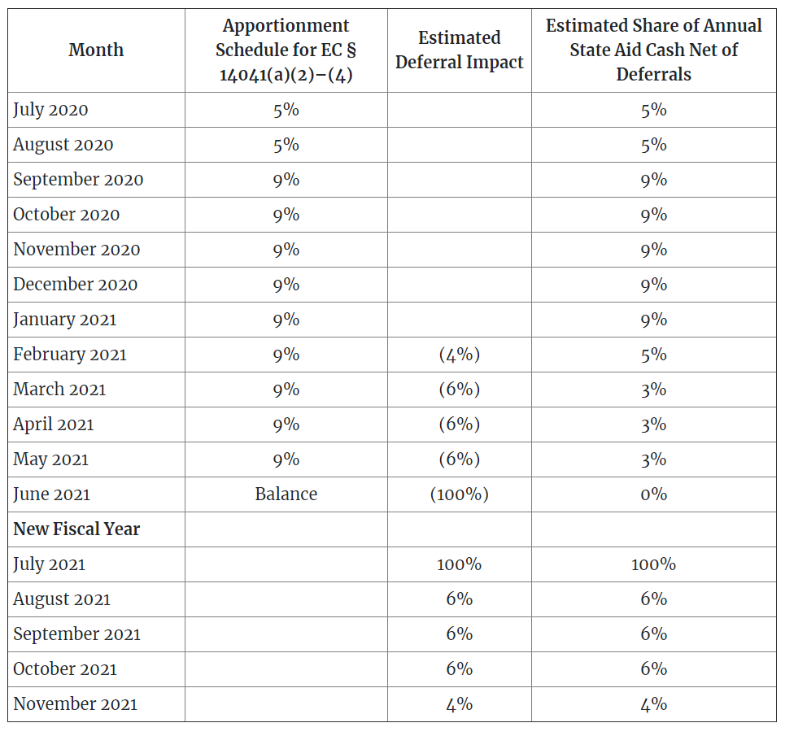
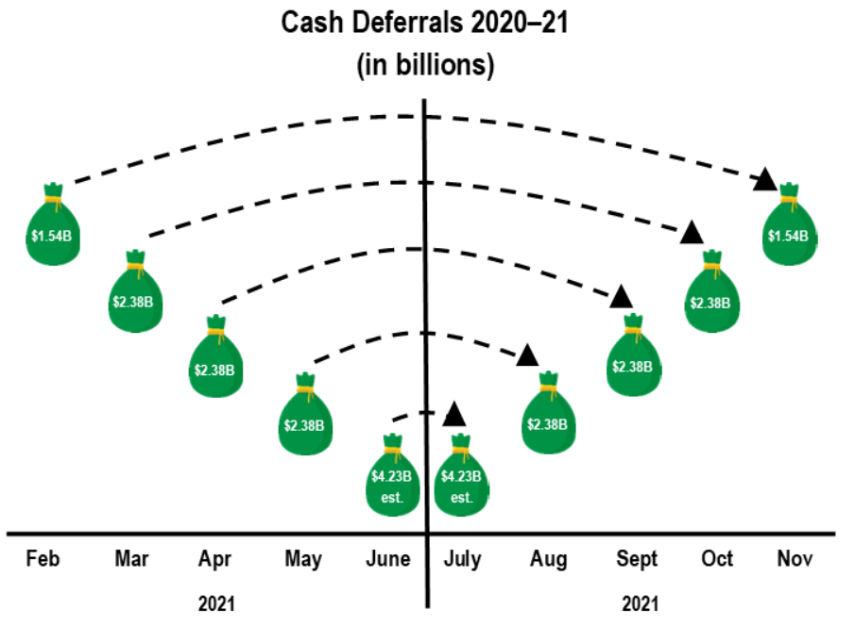
Deferrals
The state will defer portions of the apportionments due to districts beginning in Feb 2021
Cash will be monitored on a monthly basis

Slide 7
Multi-Year Projection
Declining Revenues
0% COLAs
Lower Unduplicated Pupil Percentage (UPP) 3-Year Average
Increasing Expenses
Step and Column Increases
Increases to Cal PERS/Cal STRS and Health and Welfare
District continues to have a structural deficit
District will be unable to meet state- and board-mandated reserves unless expenses reduced significantly over next several years

